Slide 1
Ace the Space
Modern way of Acing the job market
Team– Garima Mathur, Varun Prasanna Rao and Amit Balasaheb Gangane

Slide 2
Project Objective
We aim to create a recommendation system that analyses resumes against job market requirements. Provide actionable insights for improving resume alignment with job demand and scores based on algorithm.
Scope:
Review and compare resumes with job profiles in demand.
Future Scope:
Offer recommendations for improving resumes based on current job market trends.
Key Features:
Resume Analysis: Evaluate the technical skills, experience, education, and other key elements of a resume.
Market Trends: Compare the resume against current job trends and employer requirements.
Personalized Recommendations: Suggest areas for improvement, including skills to acquire or highlight.

Slide 3
Key Timeline and Milestones
Phase 1: Research & Data Collection (2 weeks)
Collect job market data from Kaggle and professional platforms.
Collect dataset using python libraries, such as Faker, which can help in generating unique entries.
Phase 2: Resume Analysis Algorithm Development (6 weeks)
To build an algorithm that extracts key resume details and compares them with job requirements. Testing and refinement will ensure accuracy, making it a reliable tool for efficient candidate evaluation.
Develop a recommendation engine that ranks candidates based on skills and experience, using scoring and machine learning to ensure accurate and fair hiring decisions.

Slide 4
Data Preprocessing
Dataset Description
Sources:
Kaggle
Open search
Key Features Used:
Job Titles - job title represents the designation associated with a particular job description.
Skills- list of technical and soft skills required for a given job.
Job Descriptions - A textual summary of a job, specifying responsibilities, required skills, and qualifications.
Cleaning & Formatting:
Removing missing values
Standardizing text data
Feature Engineering:
One-Hot Encoding for skills
TF-IDF Vectorization for textual features

Slide 5
Algorithm Structure
Resume-Job Matching: Scoring & Analysis
TF-IDF + Cosine Similarity –
TF-IDF (Term Frequency-Inverse Document Frequency), converts textual job descriptions into numerical values based on word importance.
Cosine-Similarity measures similarity between two texts by comparing vector angles in a high-dimensional space.
BERT – Job-resume matching
BERT (Bidirectional Encoder Representations from Transformers) is a powerful NLP model used for semantic understanding of text, it captures the meaning behind job descriptions & resumes.
KNN/ Random Forest – Training the model
KNN finds the closest job roles based on skill similarity.
Random Forest is a decision tree-based ensemble model that improves accuracy.

Slide 6
Working of the model :
START
Load Dataset
Clean column data + extract job roles & skills
One-hot encode skills
Train Model (KNN/ Random Forest)
Evaluate model (accuracy, precision, F1-score, Recall)
Cross-validation
Extract User skills from resume
Transform user skills or prediction
Predict best matching job role
Display result (Job role + matching score)
END

Slide 7
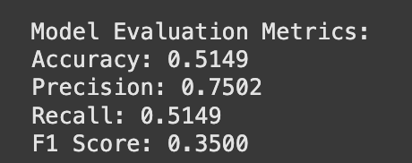
Model Evaluation
Accuracy: 51.49%
Precision: 75.02%
Recall: 51.49%
F1-Score: 35.00%
Key Observation:
With an accuracy of 51.49%, the model shows potential but has room for improvement in making more consistent and reliable predictions.
The model demonstrates strong precision at 75.02%, meaning that when it predicts a designation, it is often accurate.
With 51.49% recall, it successfully identifies a significant portion of relevant cases, though there is room to capture even more.

Slide 8
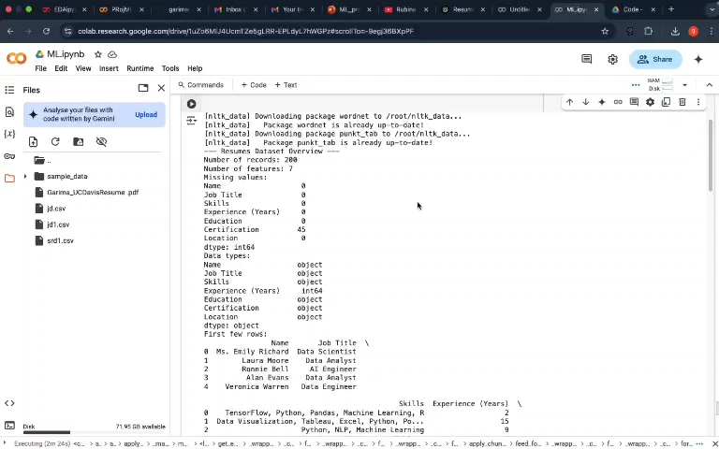
EDA of data

Slide 9
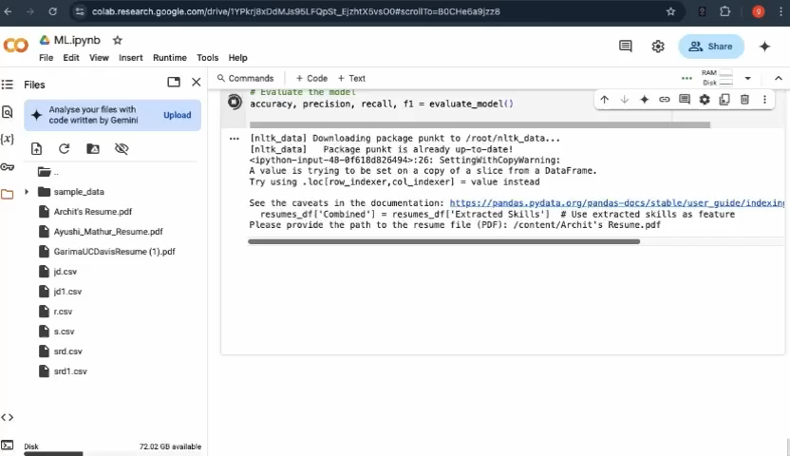

Slide 10
Challenges
Selecting the proper dataset
Choosing the right model
Low generalization due to dataset limitation
Case sensitive or abbrevation can affect the searching.
Future Scope
Advancement in Recommendation System Implementation (future consideration)
Incorporate personalized suggestions based on resume-market alignment.​
Explore Deep Learning models for textual analysis
Increase dataset size for better learning
Improve skill extraction with NLP

Slide 11
Conclusion
In today’s fast-changing job market, finding the right opportunity can feel overwhelming. Our AI-powered job role prediction system makes this process easier by using Natural Language Processing (NLP) and Machine Learning to match candidates with the most suitable roles. By analysing skills and job descriptions, it provides smart, data-driven insights that help both job seekers find the right fit and employers connect with the best talent—making hiring faster, fairer, and more efficient.
What makes this project impactful?
Efficiency: Automates manual job-matching efforts.
Scalability: Can be expanded for multiple industries and roles.
Future-Ready: With advancements like BERT and Deep Learning, accuracy and relevance can be further improved

Slide 12

THANK YOU!
We are up for any questions?

